Slide 1
MS302
Business Analytics Project
(Business Intelligence in Education)
Group 11

Slide 2
Project
Objective
Predicting Student Performance using Educational Data Mining (EDM) Techniques in Secondary School.
Problem Statement
How to accurately analyse the student’s performance in school and find out which factors affect their academic performance?

Slide 3
Our Flow
Data Collection
Data Analysis
Selection of Classification Model
Prepare Dataset for Modelling
Predict the student’s performances
Results and Conclusions

Slide 4

1. Data Collection
Features Analysed
Three Level Classification
Romantic Status
Alcohol Consumption
Parents Education Level
Frequency Of Going Out
Desire Of Higher Education
Living Area
Good
Fair
Poor

Slide 5
2. Data Analysis
Math/Portuguese
G1 - first-period grade (numeric: from 0 to 20)
G2 - second-period grade (numeric: from 0 to 20)
G3 - Final Grade (numeric: from 0 to 20, output target)
Dataset contains features like-
Student's school, student's sex, student's age, student's home address type, family size, parent's cohabitation status, mother's education, father's education, mother's job, father's job, reason to choose this school, student's guardian, home to school travel time, weekly study time, failures, extra-curricular activities, attended nursery school, wants to take higher education, Internet access at home, with a romantic relationship, free time after school, going out with friends, workday alcohol consumption, weekend alcohol consumption, current health status, number of school absences
these affect
*Exploratory Data Analysis in the report.

Slide 6
3. Classification
Models
Three Level Classification
Decision Trees
Random Forest
SVM
Logistic Regression
ANN
Naïve Bayes
Good
Fair
Poor

Slide 7
4. Prepare Dataset for modelling
Steps
Slicing Dataset (Taking out Final Grade)
Test Train Split (7:3)
Total features - 58

Slide 8
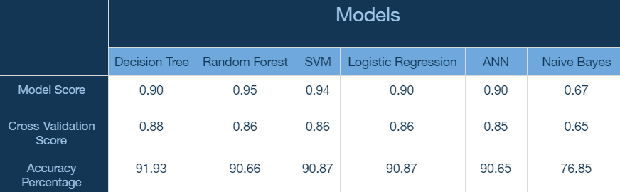
5. Prediction
*More detailed description in the report.

